Slide 1
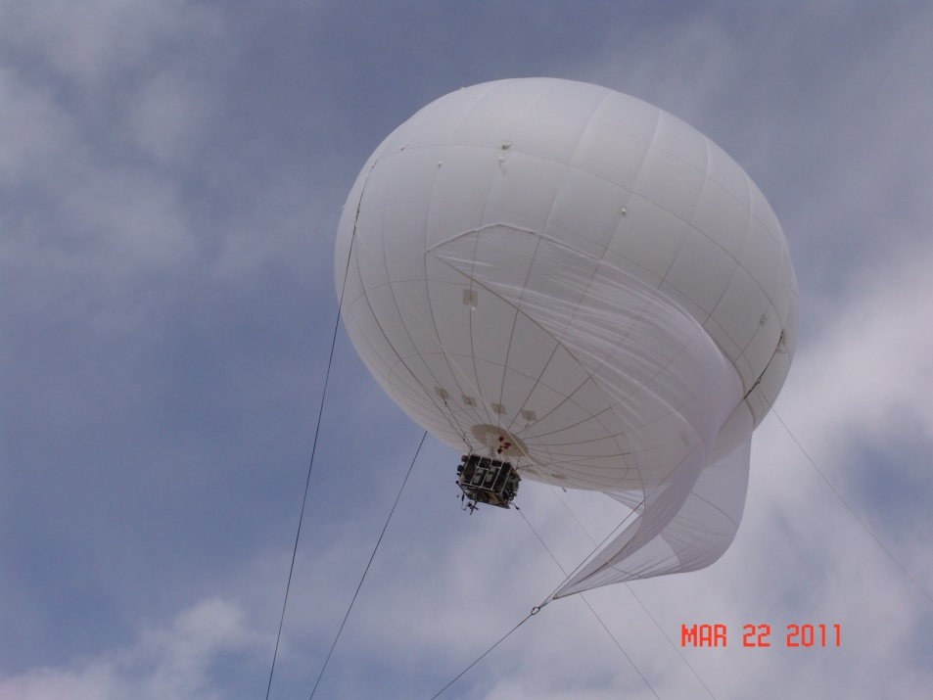
Technical Approach – U.S. EPA
Emission sampling and wind velocity measurement
A 14’ diameter tethered aerostat was used to loft a battery operated instrument package.
  Real time PM by size
  Semivolatiles
  CO2
  3D sonic anemometer

Slide 2
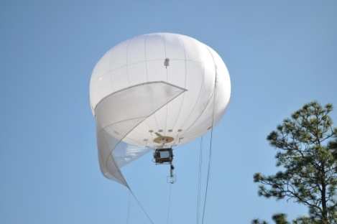
RESULTS. Continuous PM and CO₂
Eglin 2/8/2011
2-min running average

Slide 3
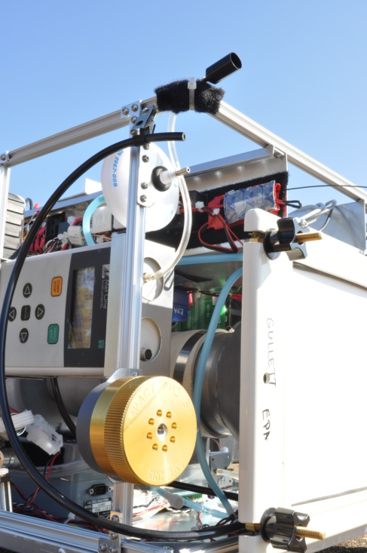
Continuous PM
Continuous PM sampler
2-min running average
Eglin 2/6/2011

Slide 4
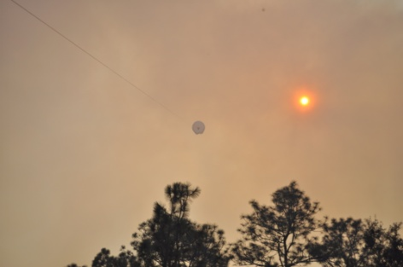
Continuous PM
2-min average
Eglin 2/8/2011

Slide 5
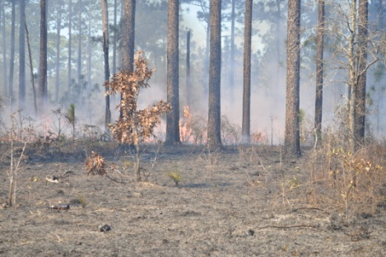
Continuous PM
Eglin 2/12/2011
2-min average

Slide 6
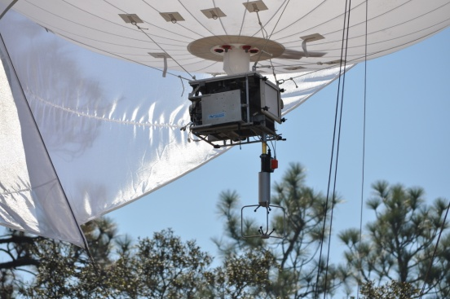
Continuous PM_{2.5} and CO₂
2-min average
Eglin 2/6/2011

Slide 7
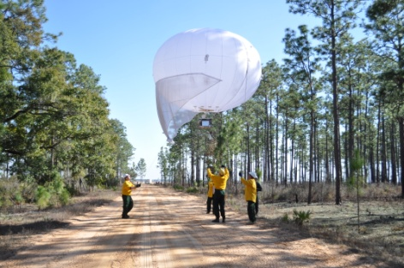
Continuous PM_{2.5} and CO₂
2-min average
Eglin 2/8/2011

Slide 8
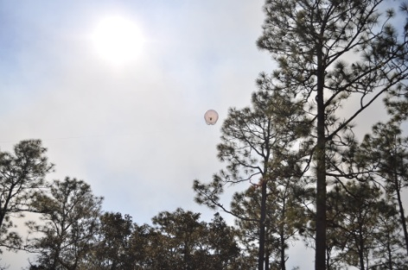
Continuous PM_{2.5} and CO₂
2-min average
Eglin 2/12/2011

Slide 9

Results
PM_{2.5} Emission factor
0.013 g/g Carbon ±13% (RPD)
Other Results Anticipated:
3D wind velocity over time and altitude
Semi-volatile emission factors
Background corrected
PM by weight/filter
Carbon from CO₂
RPD = Relative Percent Difference (two samples)
PM 2.5 impactor sampler
Notes:
Background PM2.5 from 2/10/11 when no burns were conducted

Slide 10
Status of Funds for Federal Performers (EPA)
Report on the status of funds for each MIPR received by a directly funded Federal performer. Provide information on each fiscal year for which there has not been 100% expenditure of funds.
FY200X Funds
Directly Funded Federal Performer(s) | Funds Received | Funds Obligated* | Percent Funding Obligated
U.S. Navy (ISSI, Inc. Task Order for U.S. EPA) - Direct Cite MIPR | 34.9K | 34.9K | 100%
U.S. EPA - Reimbursable MIPR | 15.1K | 11.8K | 78%
Federal Performer B - Direct Cite MIPR | 100K | 100K | 100%
Federal Performer B - Reimbursable MIPR | 100K | 50K | 50%
* Funds put on contracts and/or purchase orders that have been issued and funds associated with internal labor or travel expenses that have been incurred.

